Slide 1

MENTHEAL- Mind the Mind!

Slide 2
MENTHEAL- Mind the Mind!
Proposal
Scope & Approach
Object Model
Use Cases
Problem Definition
Summary

Slide 3
MENTHEAL- Mind the Mind!
Proposal
Scope & Approach
Object Model
Use Cases
Problem Definition
Summary

Slide 4

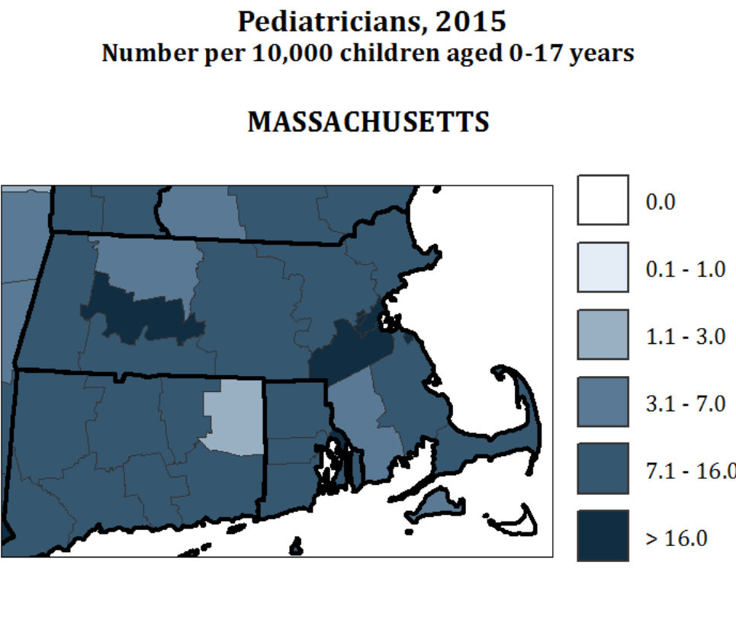
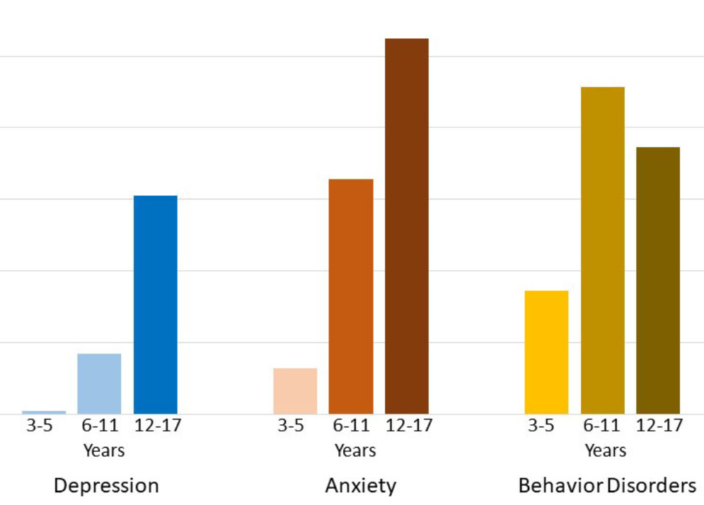
Why Mental Health?
Rising Mental Health Crisis- Depression, anxiety, addiction
Scarcity of medical providers; Inadequate Insurance coverage; Expensive treatment; Inaccessibility to information on prescriptions.
46.4% of population in United States experience mental health issues during their lifetime
Problem existing in contemporary US despite high Govt. expenditure
Half of the mental ailments developed in early teens and three quarters by the age of 24.

Slide 5
MENTHEAL- Mind the Mind!
Proposal
Scope & Approach
Use Cases
Object Model
Problem Definition
Summary

Slide 6
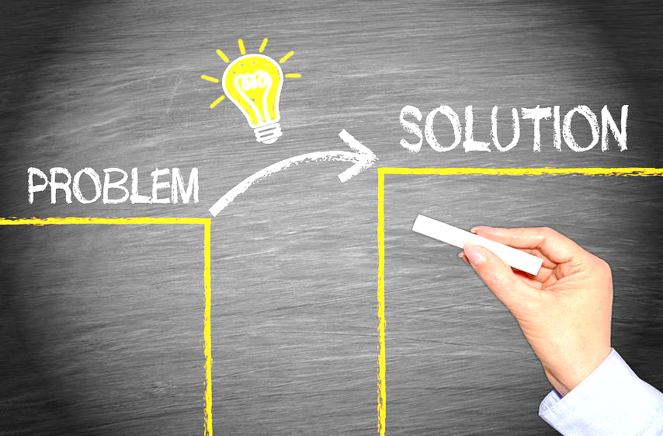
Proposal
Insurance co-ordination with
Government Entitlements.
Real-time appointment, registered doctors.
Dynamic rehab request, emotional support and provision of caretakers.
Patient tracking portal and email notifications.
Inadequate Insurance coverage
Scarcity of medical providers
Scarcity of Care Taker Organizations
Inaccesibility of prescription information.

Slide 7
MENTHEAL- Mind the Mind!
Proposal
Scope & Approach
Use Cases
Object Model
Problem Definition
Summary

Slide 8
Scope & Approach

Slide 9
Scope & Approach
Doctor
Lab Assistant
Medical Coder

Slide 10
Scope & Approach
Pharmacist
Drug Manufacturer

Slide 11
Scope & Approach
Claim Handler
Invoice Handler

Slide 12
Scope & Approach
Nurse
Caretaker
Dietician

Slide 13
Scope & Approach
Grants Provider

Slide 14
MENTHEAL- Mind the Mind!
Proposal
Scope & Approach
Use Cases
Object Model
Problem Definition
Summary

Slide 15
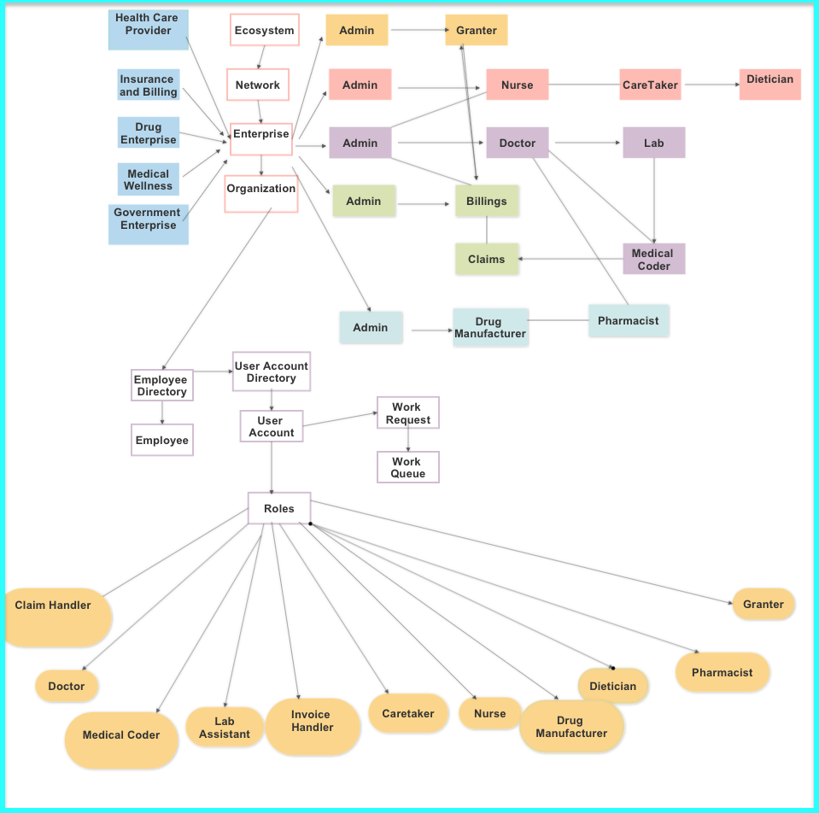
Object Model

Slide 16
MENTHEAL- Mind the Mind!
Proposal
Scope & Approach
Use Cases
Object Model
Problem Definition
Summary

Slide 17
Use Cases
MENTHEAL
Medical Records

Slide 18
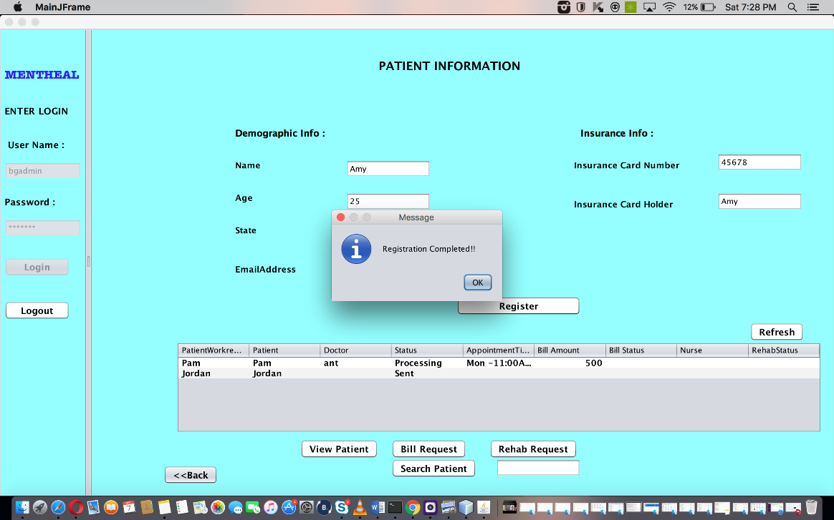
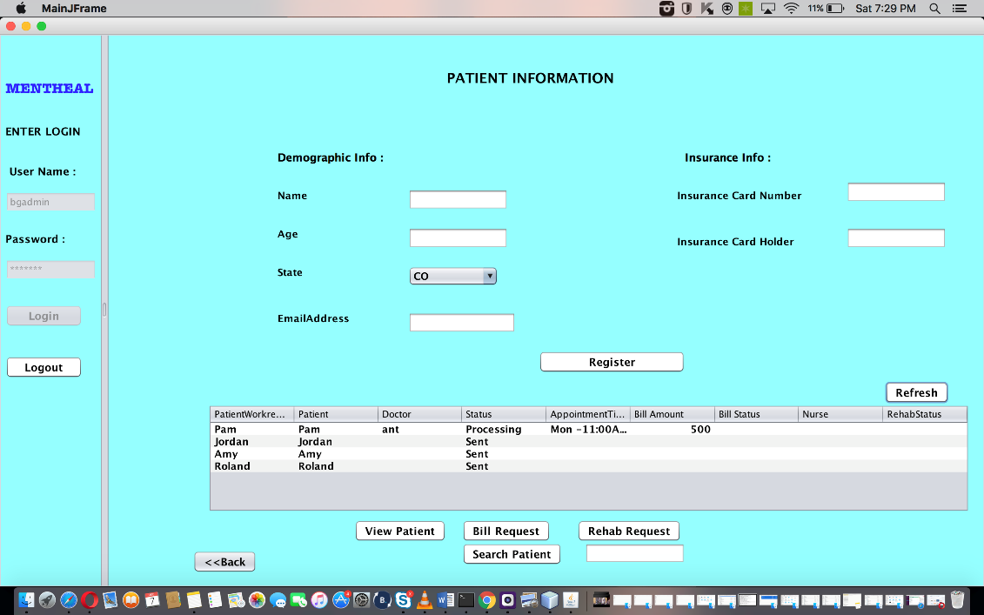
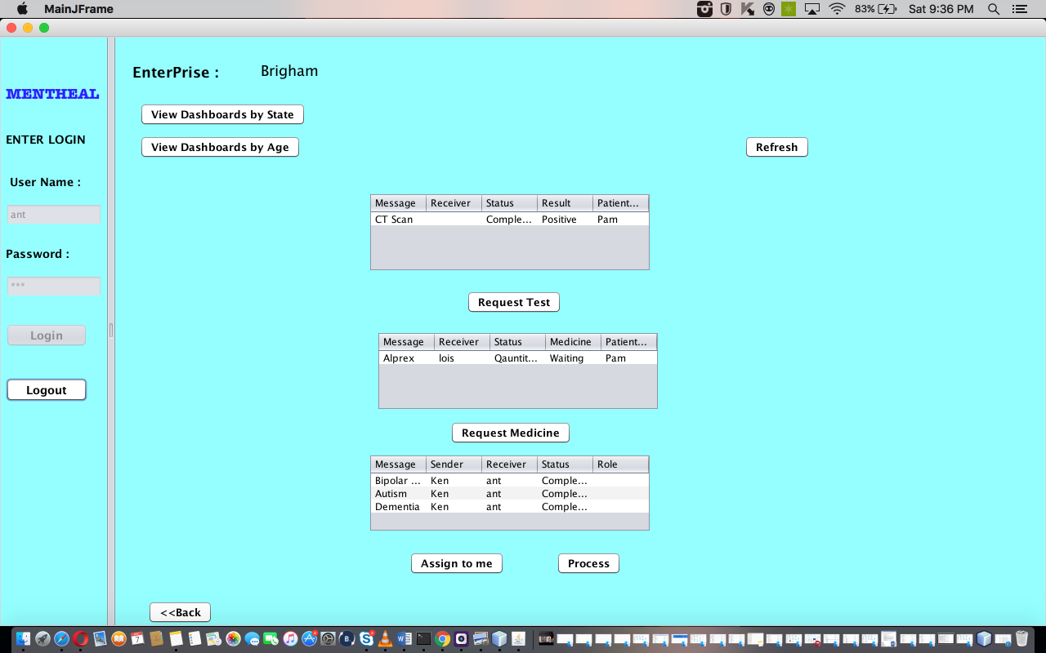
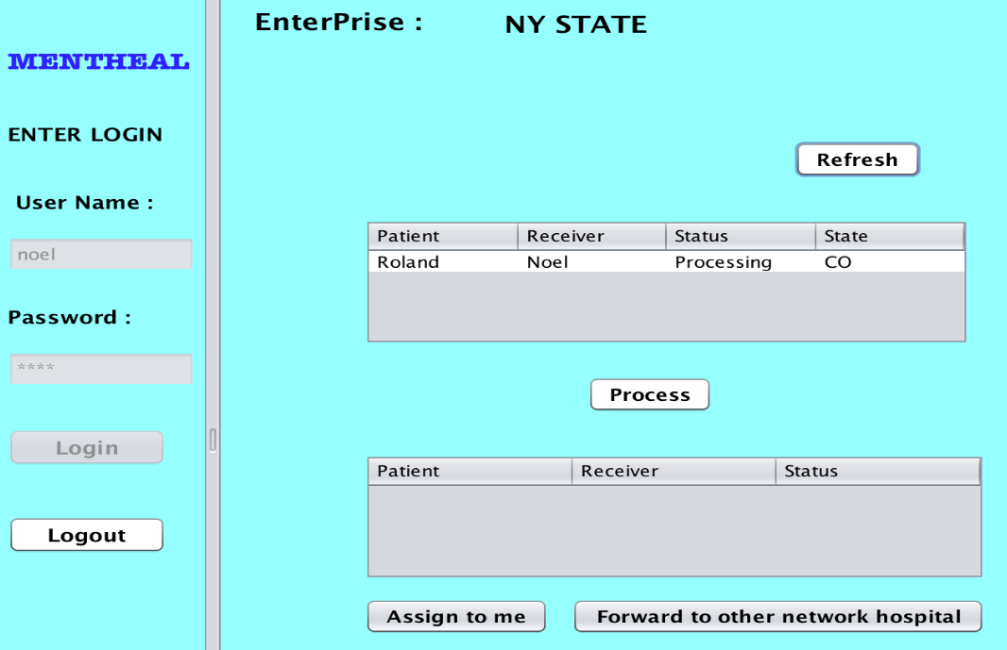
Medical Records

Slide 19
Use Cases
MENTHEAL
Medical Records
Dashboards

Slide 20
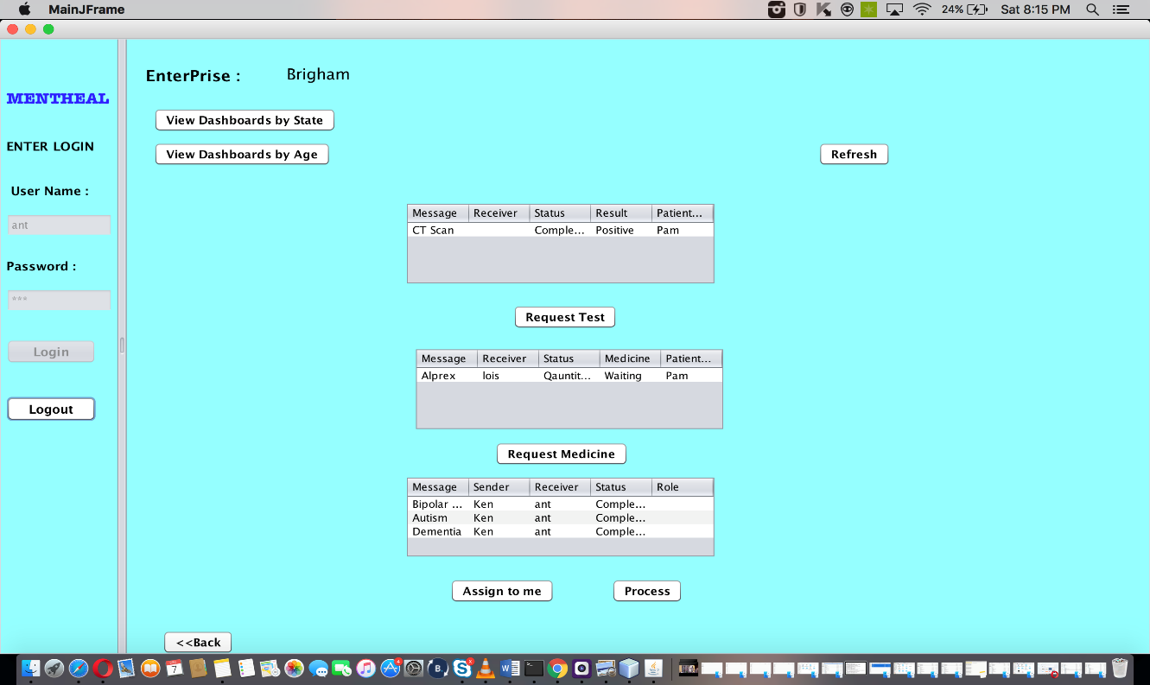
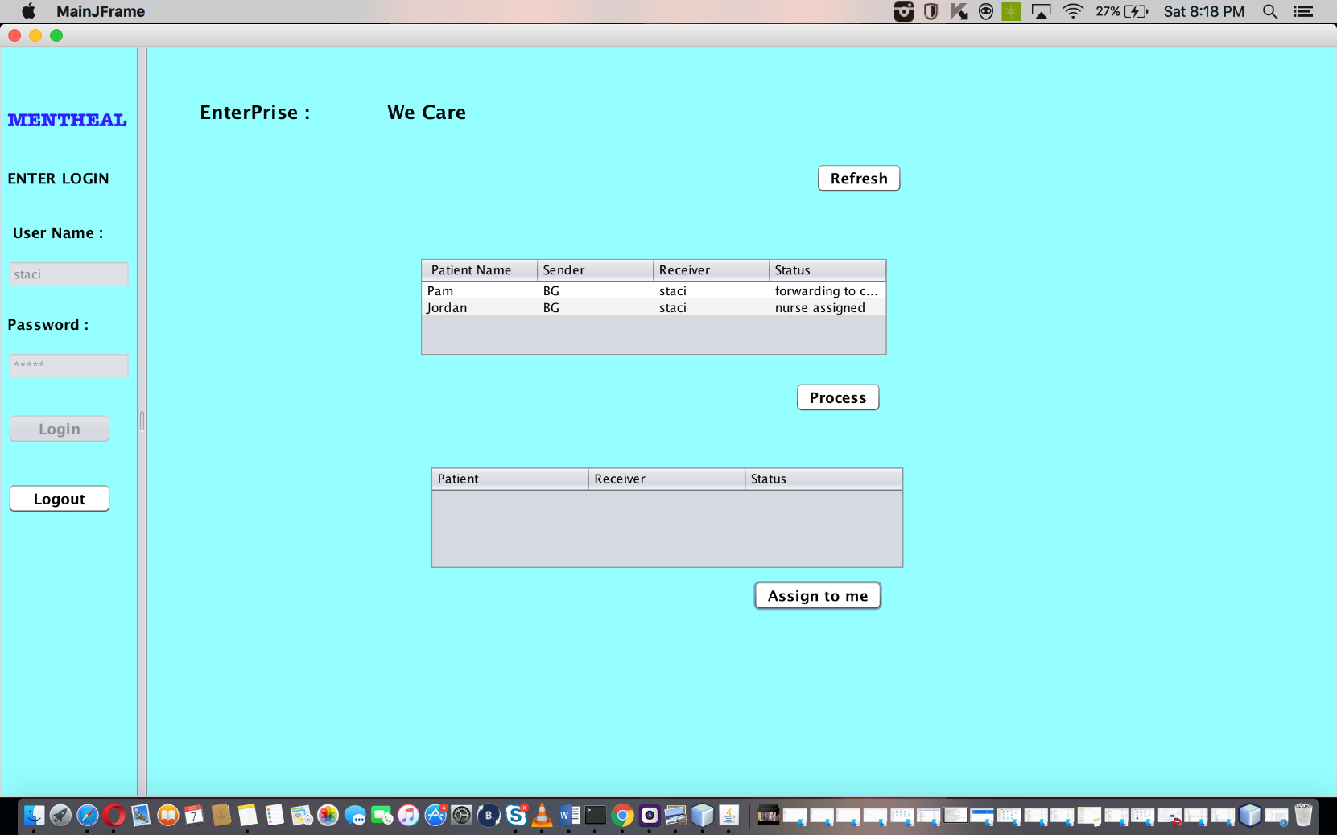
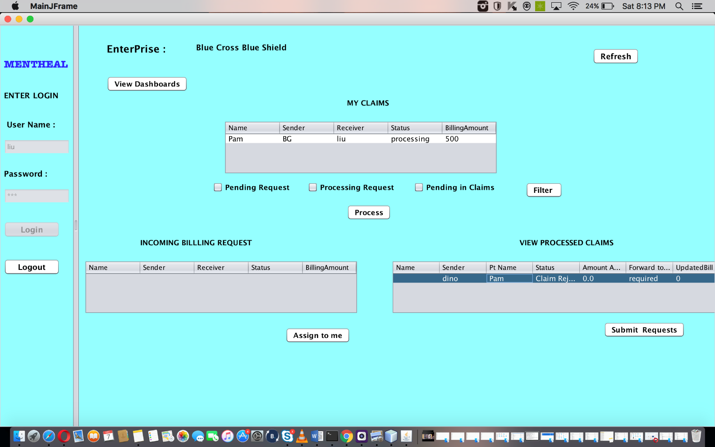
Dashboards

Slide 21
Use Cases
MENTHEAL
Medical Records
Analysis
Dashboards

Slide 22
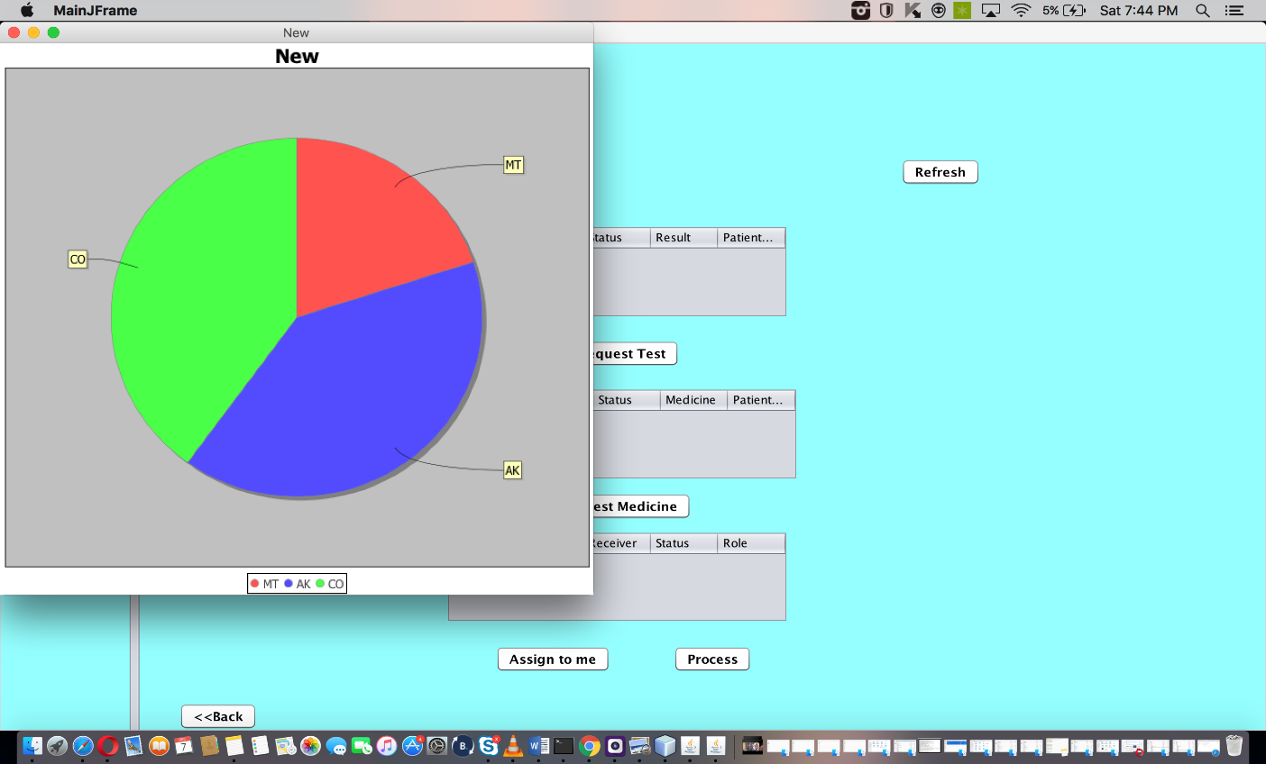
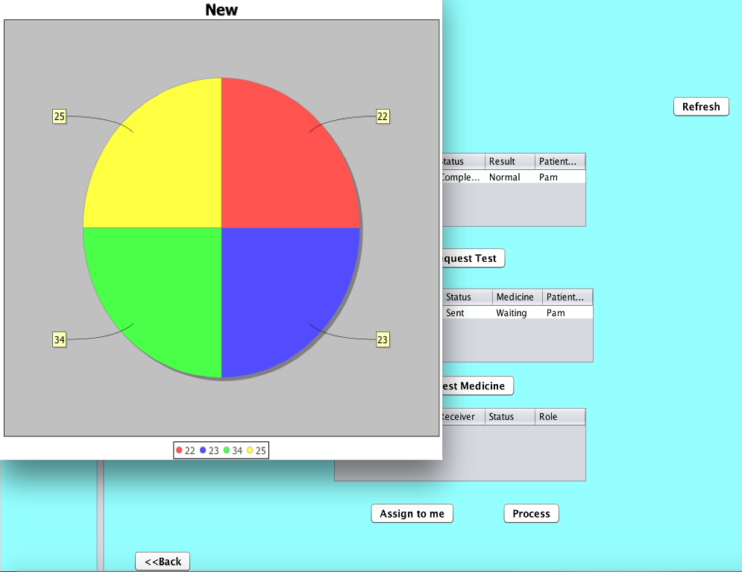
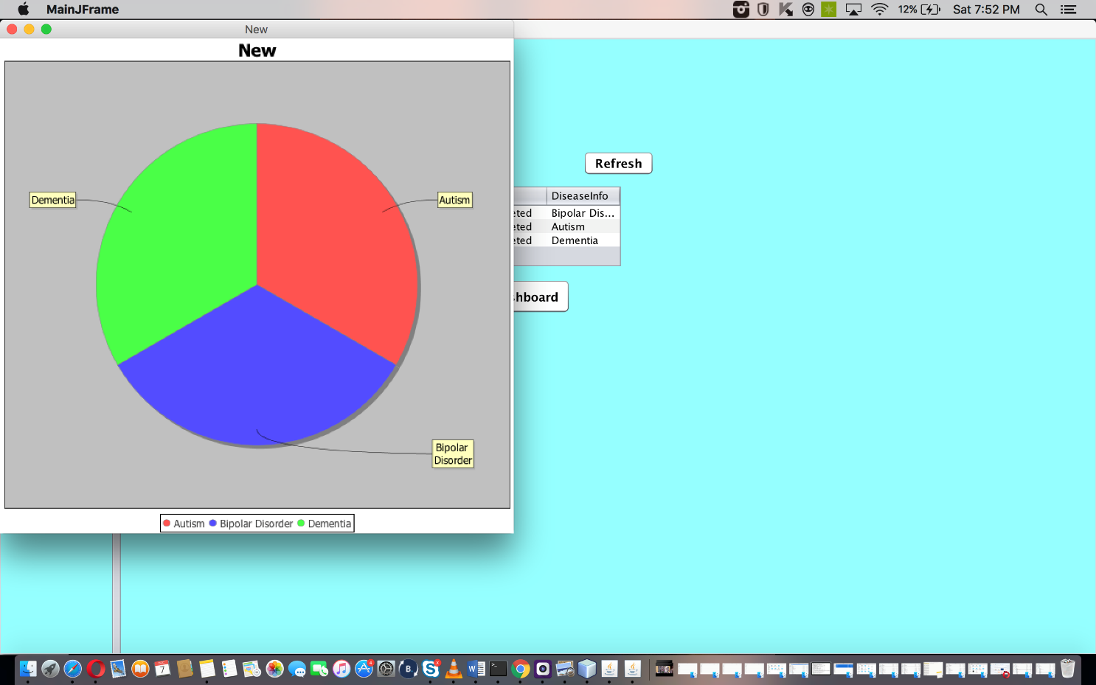
Analysis

Slide 23
Use Cases
MENTHEAL
Email Support
Medical Records
Analysis
Dashboards

Slide 24
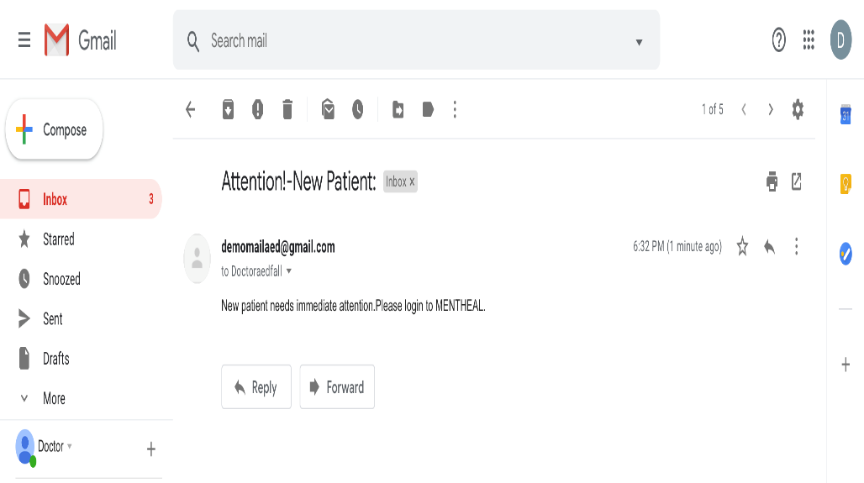
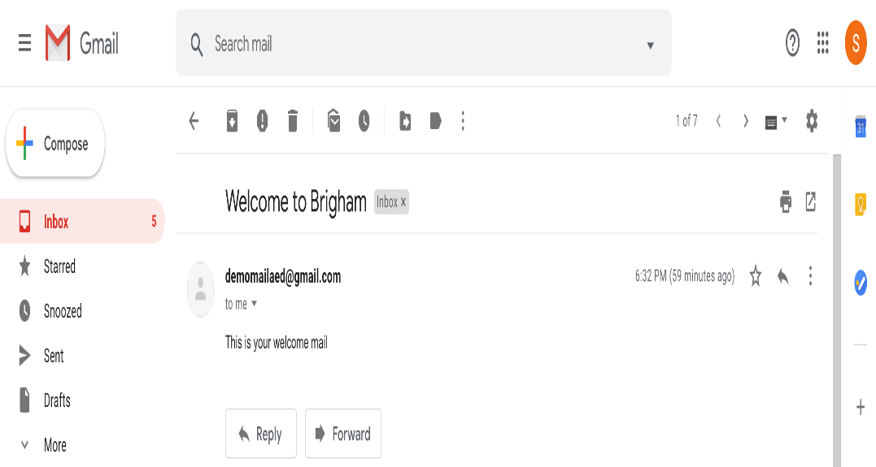
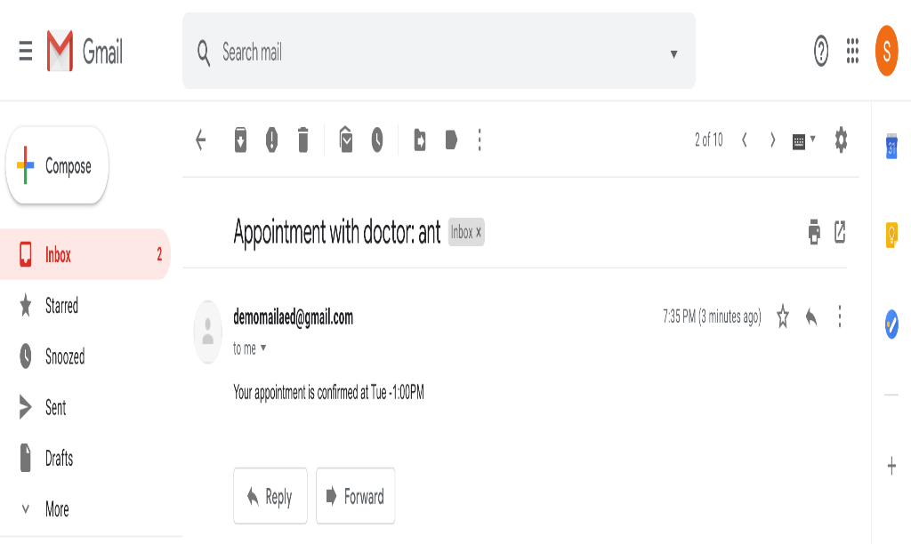
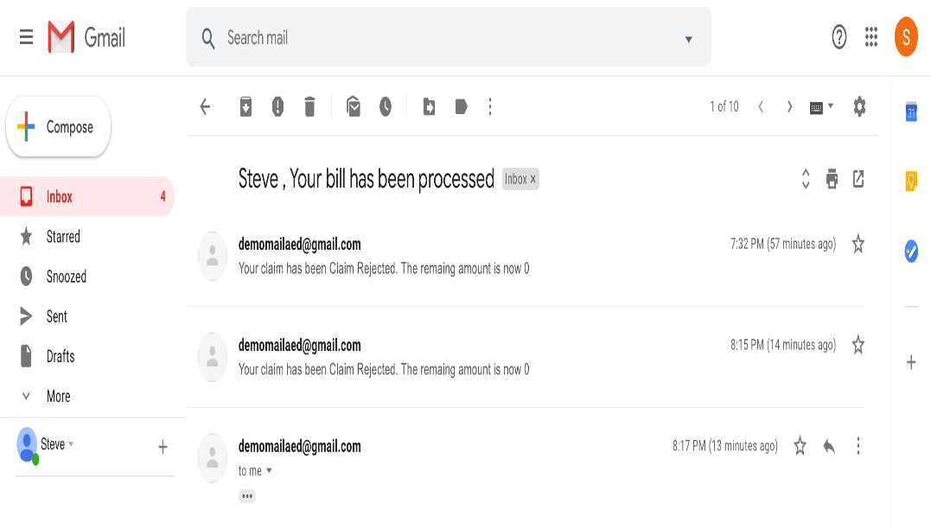
Email Support

Slide 25
Use Cases
Caretaker Support
MENTHEAL
Email Support
Medical Records
Analysis
Dashboards

Slide 26
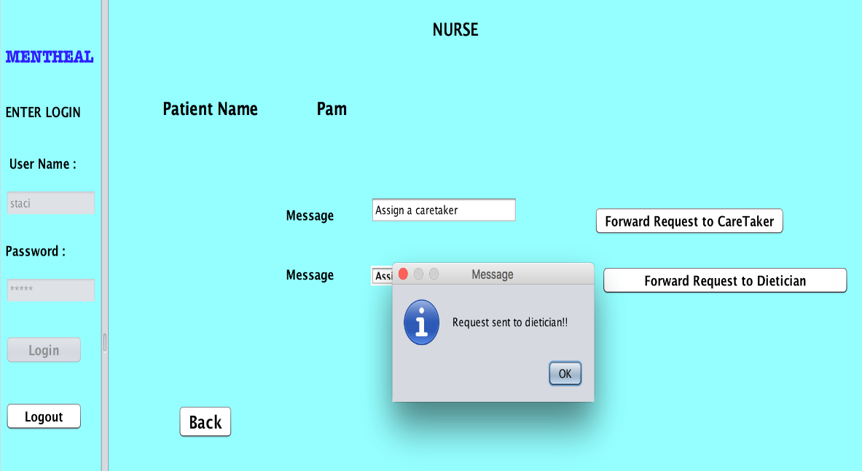
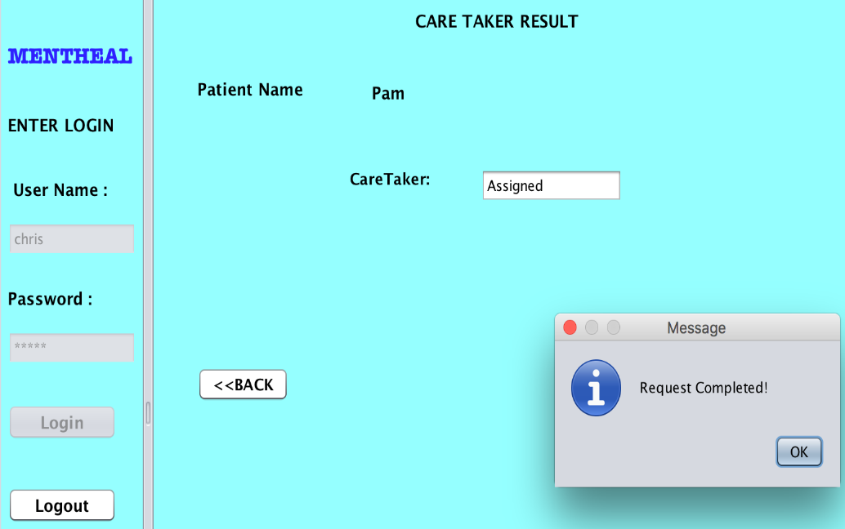
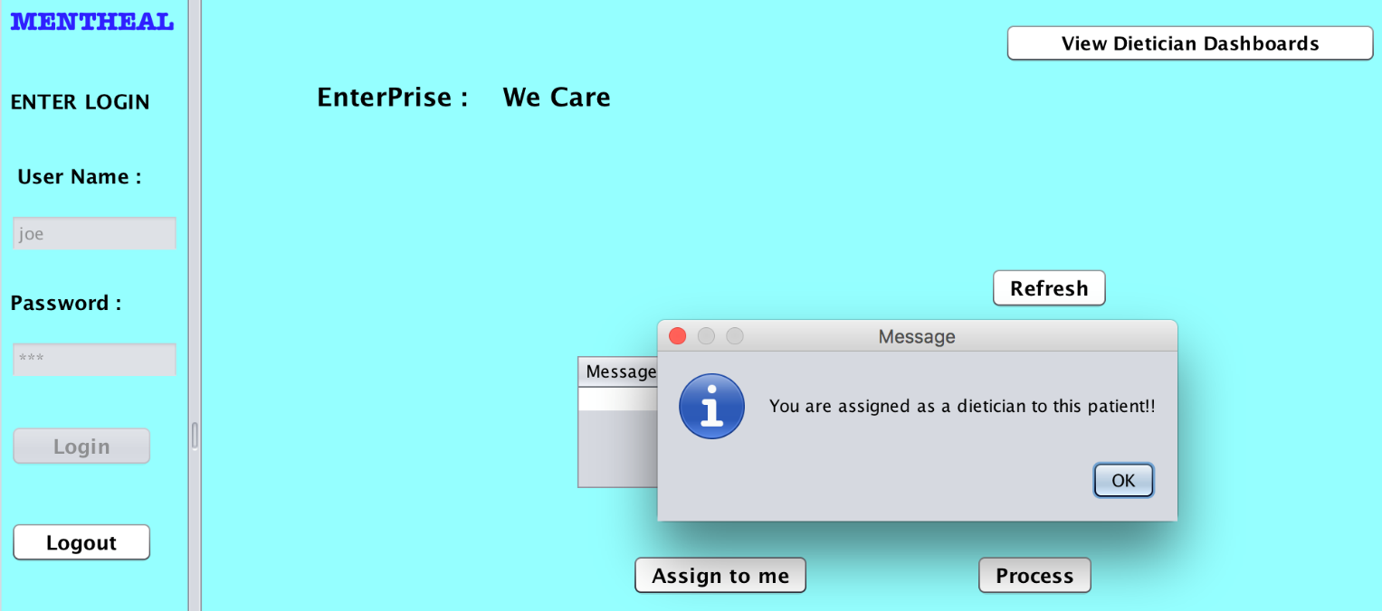
Caretaker Support

Slide 27
Use Cases
Medical Coder
Caretaker Support
MENTHEAL
Email Support
Medical Records
Analysis
Dashboards

Slide 28
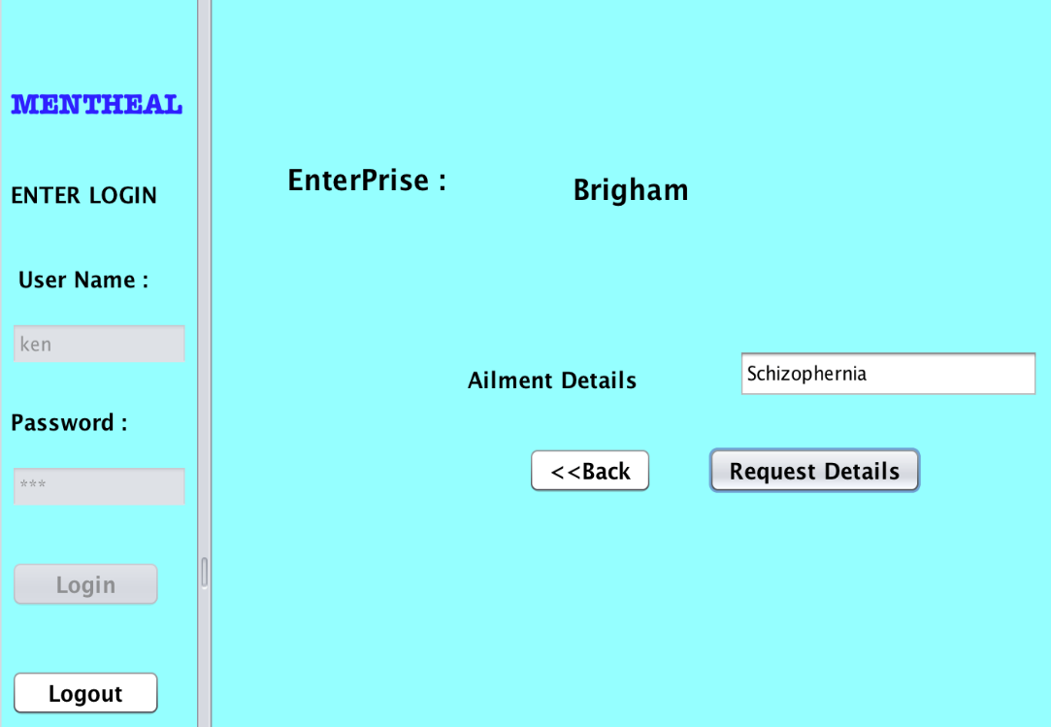
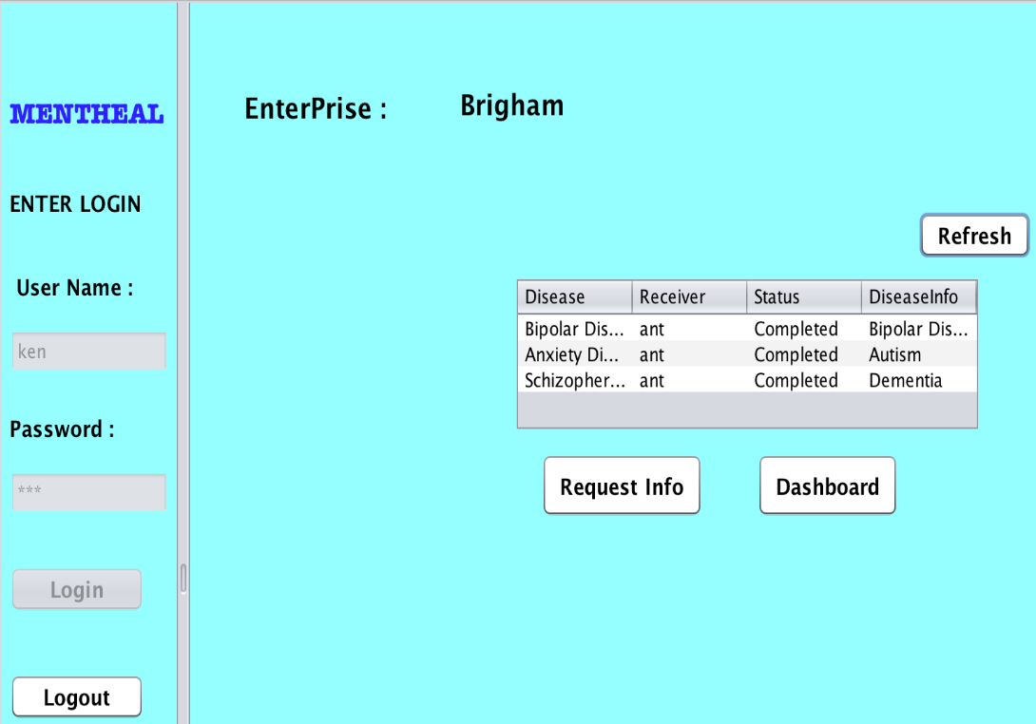
Medical Coder

Slide 29
Use Cases
Real-time Appointments
Medical Coder
Caretaker Support
MENTHEAL
Email Support
Medical Records
Analysis
Dashboards

Slide 30
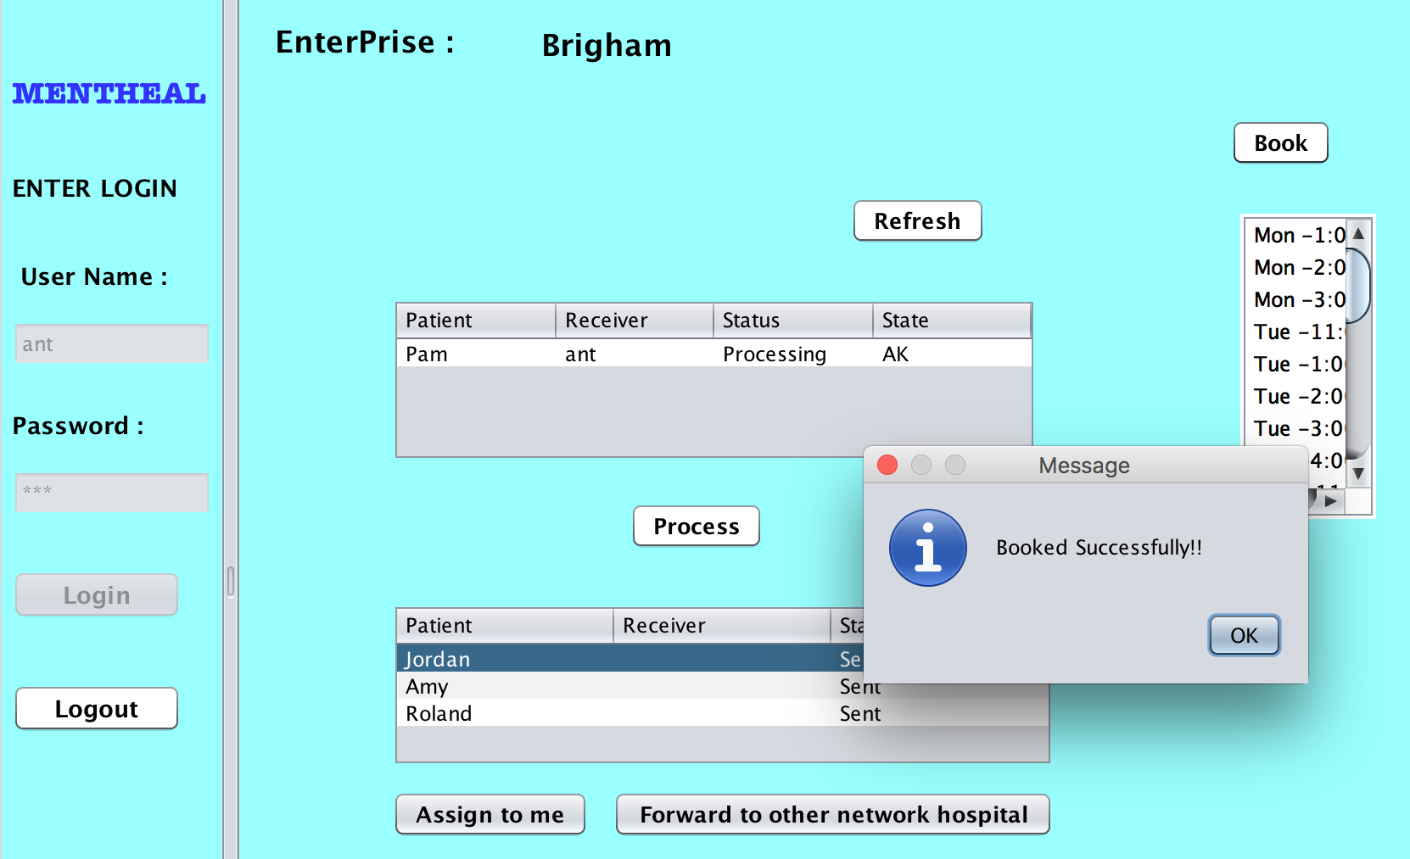
Real-time Appointments

Slide 31
Use Cases
Real-time Appointments
Medical Coder
Caretaker Support
Claims Handling
MENTHEAL
Email Support
Medical Records
Analysis
Dashboards

Slide 32
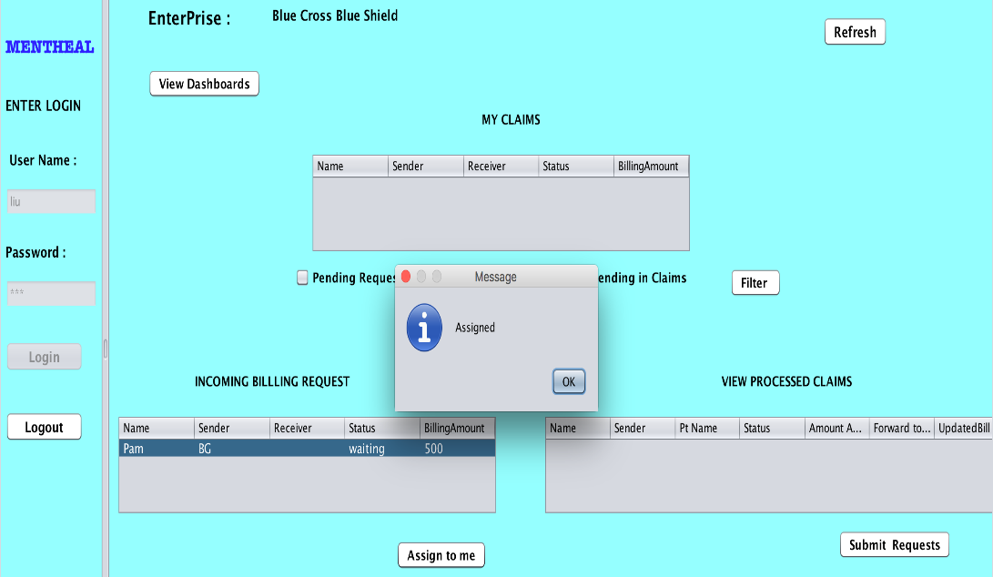
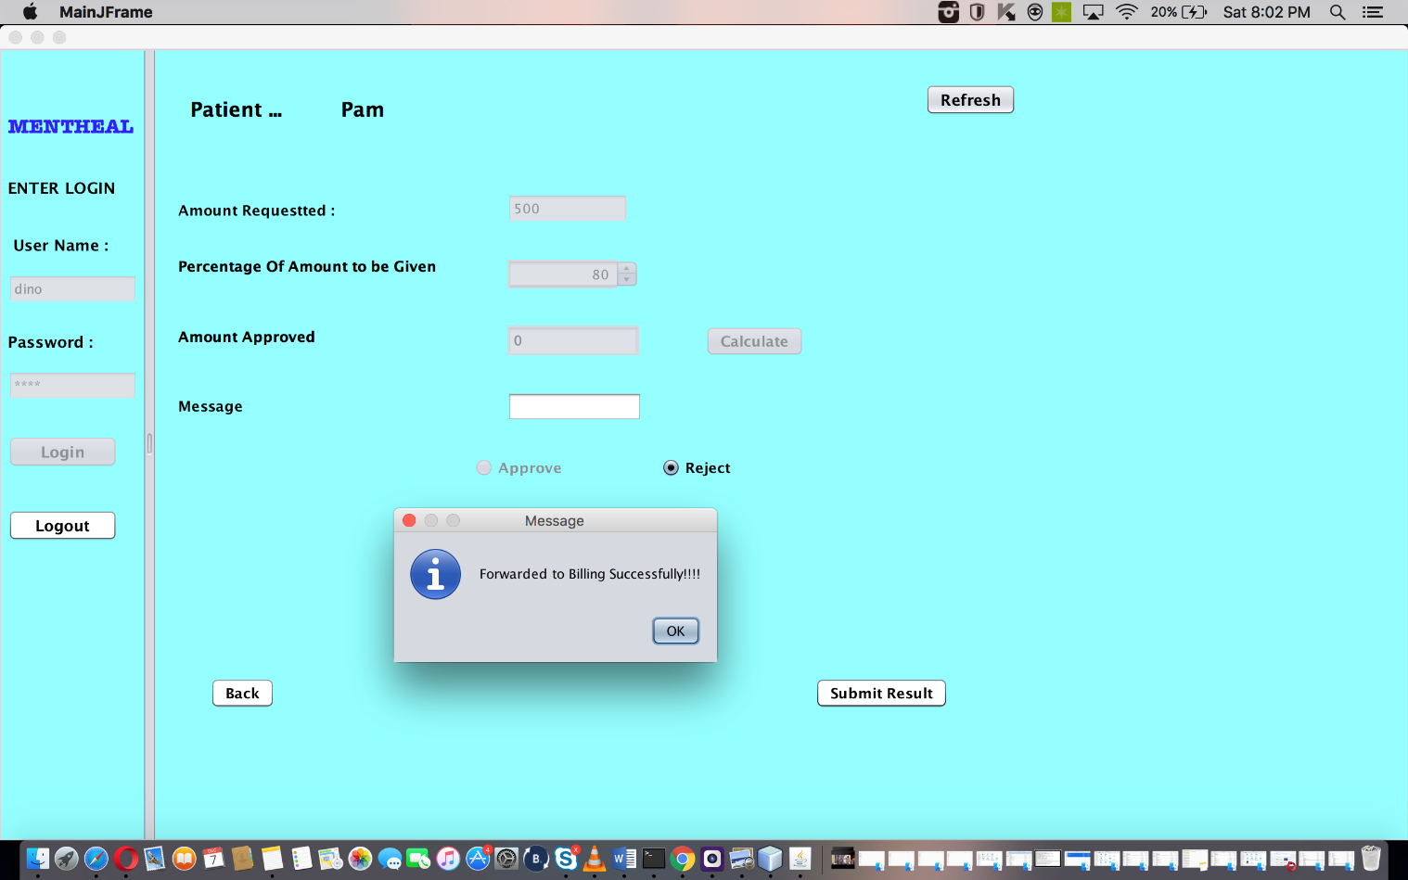
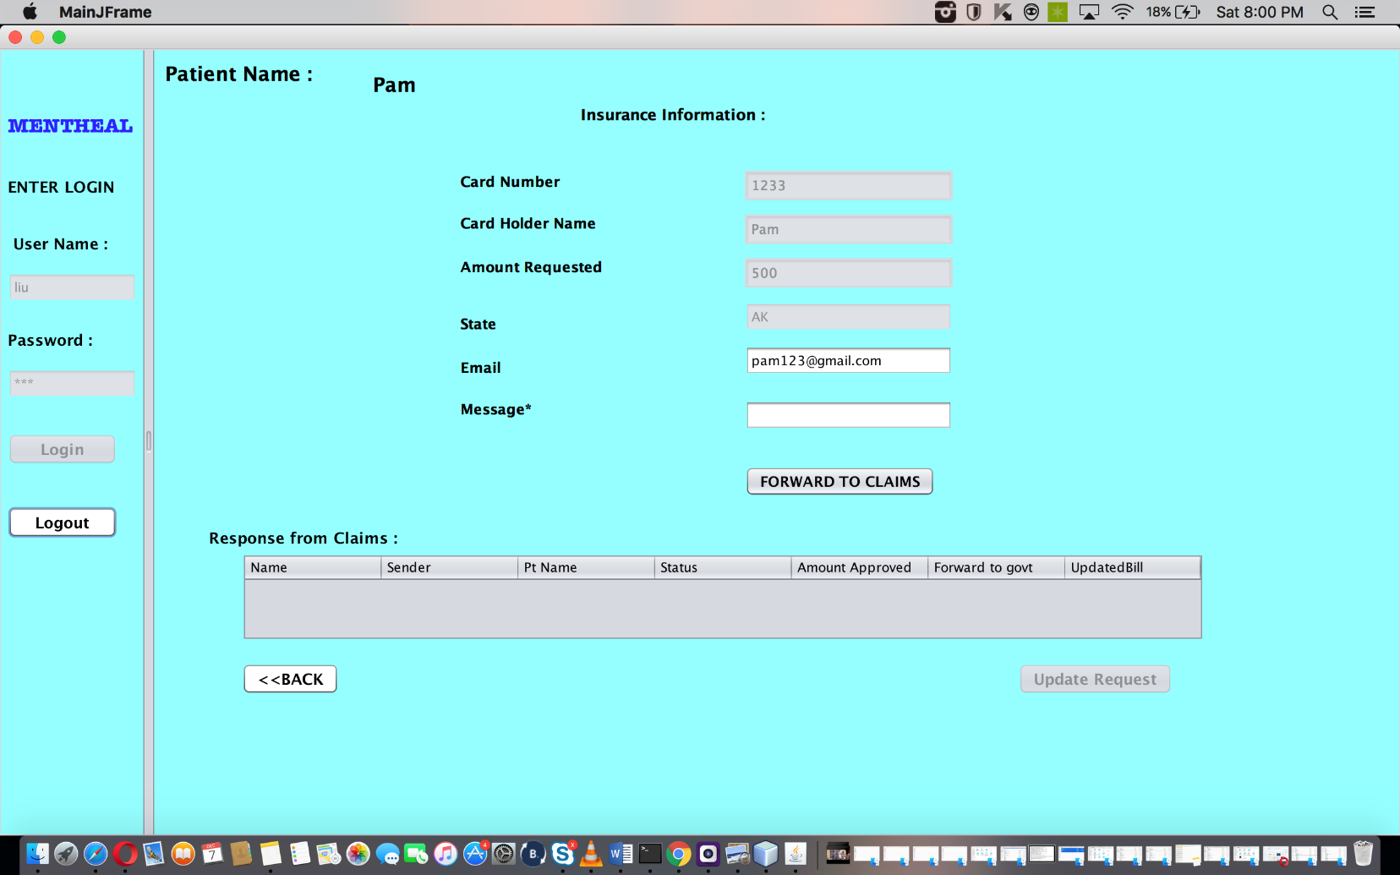
Claims Handling

Slide 33
Use Cases
Real-time Appointments
Medical Coder
Caretaker Support
Claims Handling
MENTHEAL
Email Support
Govt. Funding
Medical Records
Analysis
Dashboards

Slide 34
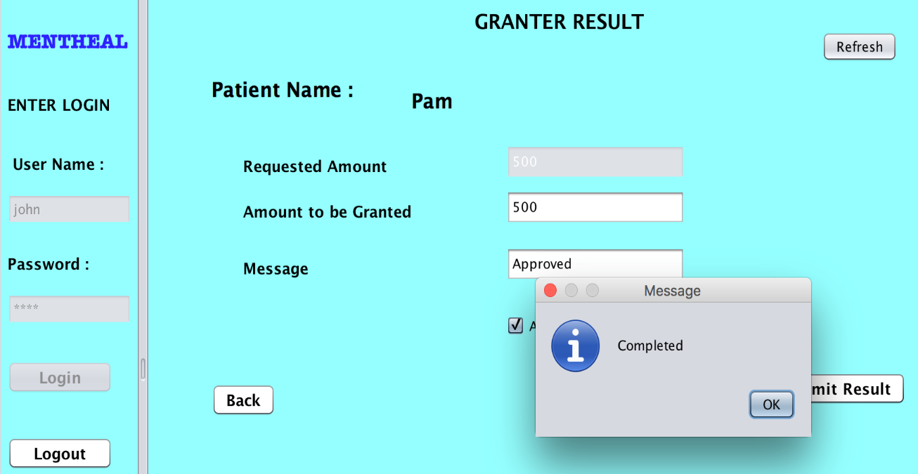
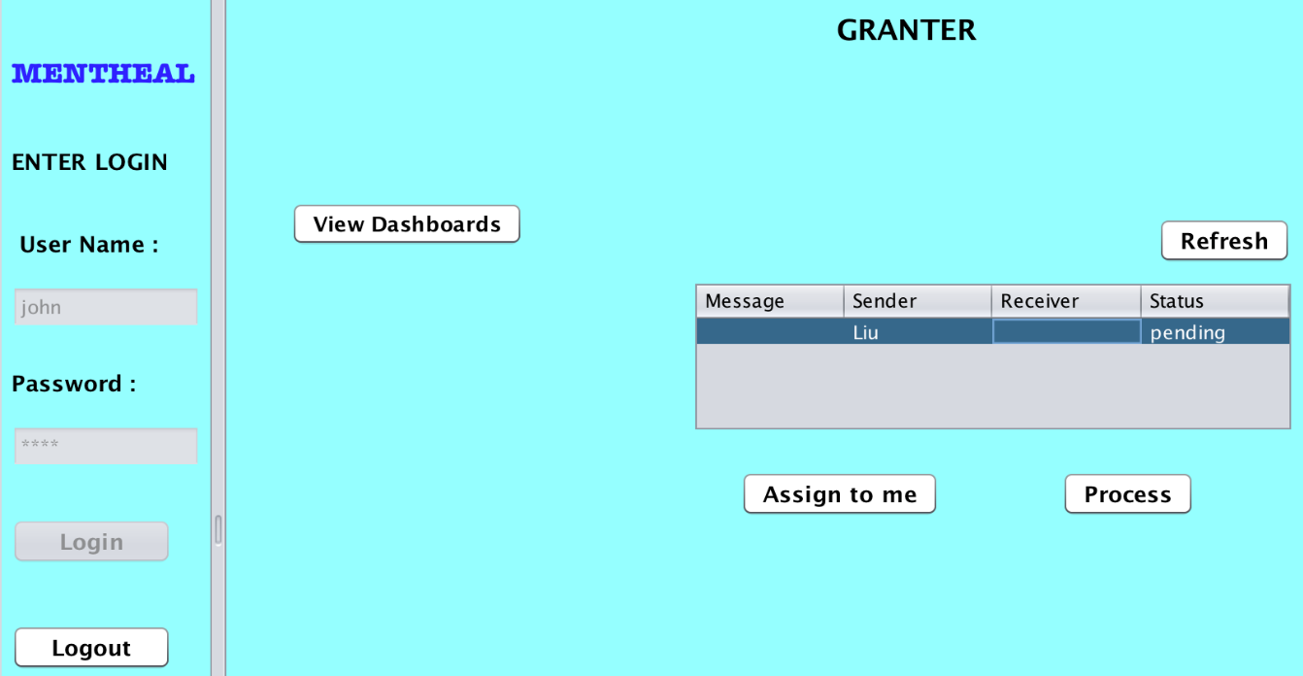
Govt. Funding

Slide 35
MENTHEAL- Mind the Mind!
Proposal
Scope & Approach
Use Cases
Object Model
Problem Definition
Summary

Slide 36

Summary
The project successfully demonstrated:
Integration of Hospital and Care services.
Availability of government funding, if required.
Delivery of immediate mental healthcare assistance.
Timely notifications, alerts and dashboard tracking.
Transparency between different enterprises.

Slide 37


